Slide 1
Word problems with pulley

Slide 2
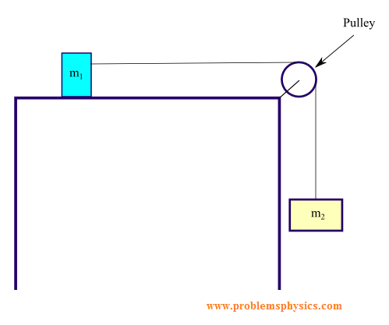
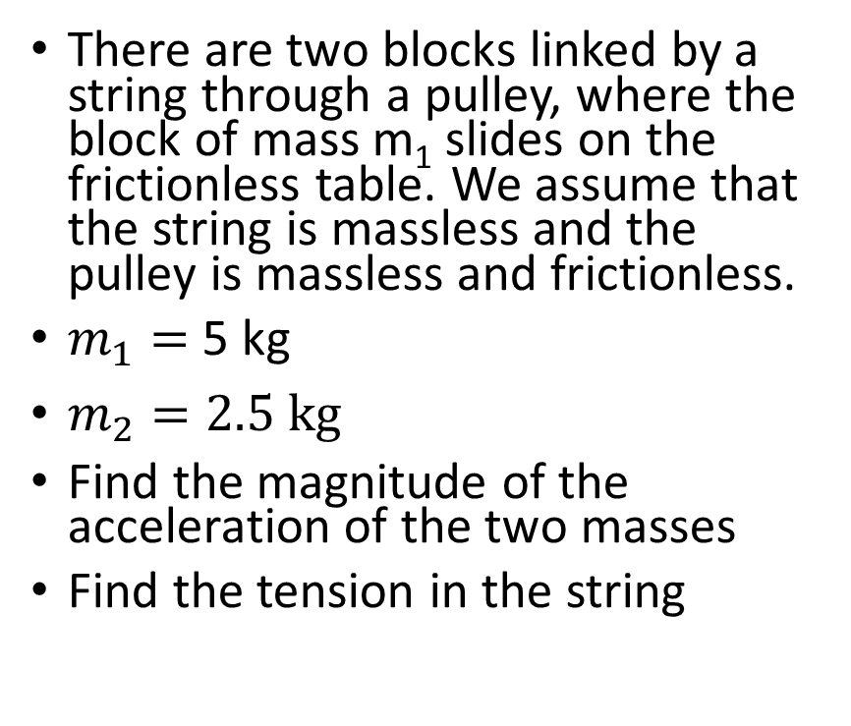
Problem 11.
There are two blocks linked by a string through a pulley, where the block of mass m₁ slides on the frictionless table. We assume that the string is massless and the pulley is massless and frictionless.
$m_{1}=$ 5 kg
$m_{2}=2.5 kg$
Find the magnitude of the acceleration of the two masses
Find the tension in the string

Slide 3

Problem 2.
The system moves with an acceleration of 2 $\frac{m}{s^{2}}$. $m_{1}=8kg, μ_{k}=0.2$
Find $m_{2.}$

Slide 4
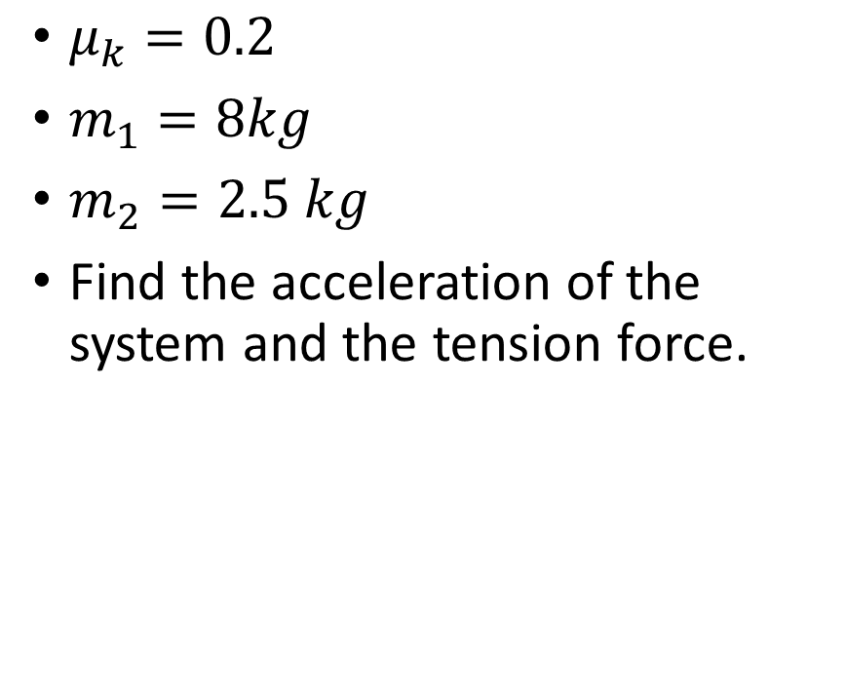
$μ_{k}=0.2$
$m_{1}=8kg$
$m_{2}=2.5 kg$
Find the acceleration of the system and the tension force.

